Slide 2
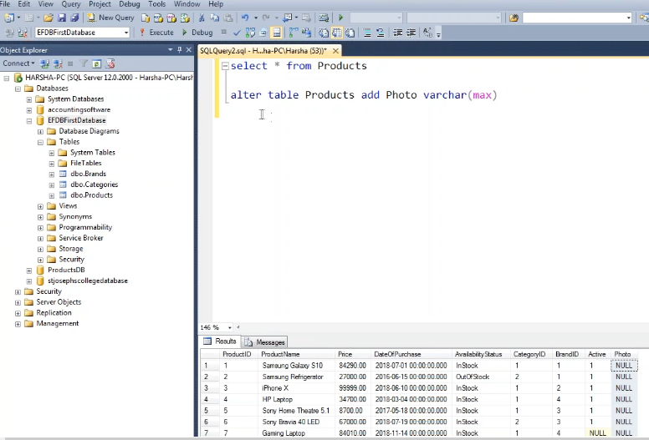

Slide 3
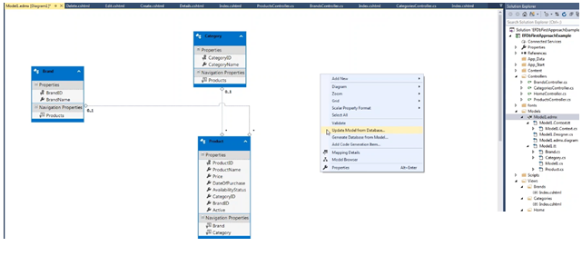

Slide 4
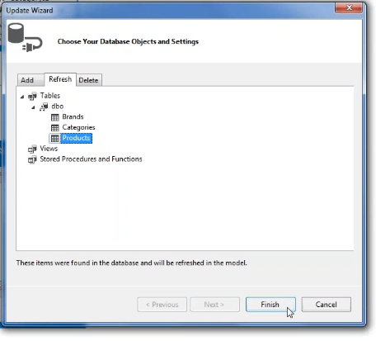

Slide 5


Now close this Model1.EDMX file. Save it.
Go to Create form. And inside the form, we have to add an Attribute called Encryption type = Multipart form data.
This Encryption type is required in order to submit the files to the server.
Add a new form-group for input type = file. here name is very Important.
This 'name' attribute must be same as model property i.e. Photo.
So when we click on the submit button along with the other fields; the photo also will be submitted to server.
we can receive the same in the Create HttpPost action method.
The Request.Ffiles property is a collection type, which contains all the files that have submitted from the browser through input type = file. But this will work only when the encryption type is Multipart/formdata like this.

Slide 6
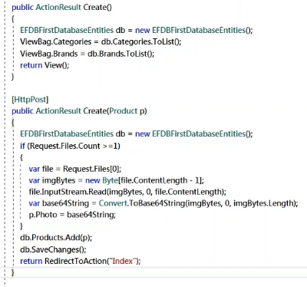

Slide 7
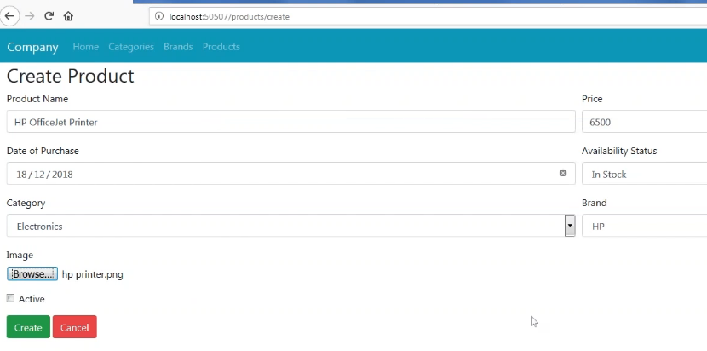

Slide 8
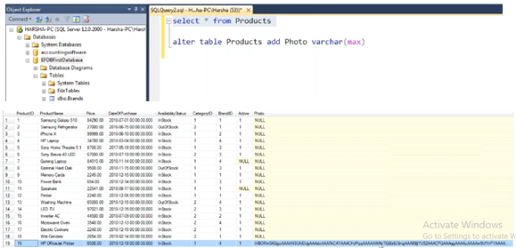

Slide 9
